Slide 1
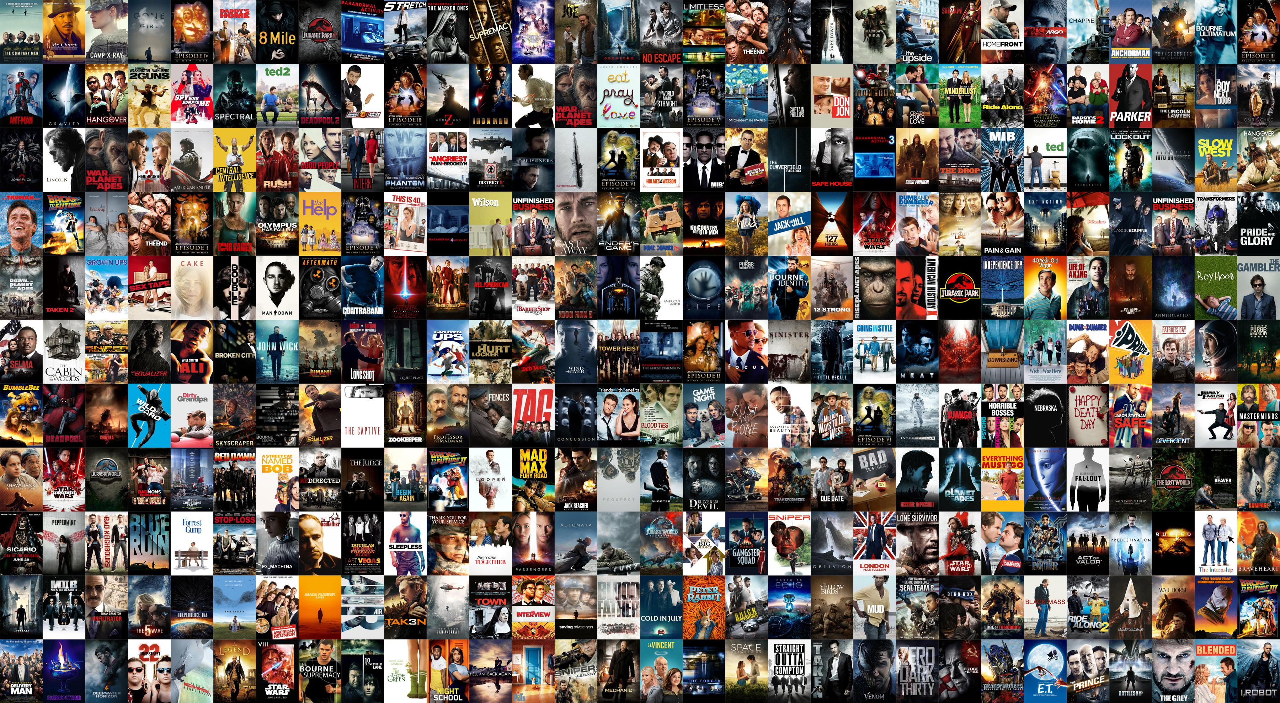


MOVIE
RECOMMENDER
SYSTEM
-Using Collaborative Filtering

Slide 2
Contents
Introduction
Collaborative Filtering
Problem Formulation
Dataset
Methodology
Experimental Analysis
Results
Conclusion
References

Slide 3
Introduction
Recommendation systems imitate this social process to enable quick filtering of the information on the web.
The most important responsibility for every recommendation system is how to make the appropriate personalized recommendation for different customers rapidly and effectively. The context of the movies is also considered while recommending. The user - user relationship as well as user - item relationship plays a role in the recommendation. Recommendations functionality displays a list of items to a user. The items are listed in the order of usefulness to the user.

Slide 4
Collaborative Filtering
Collaborative Filtering is the process of filtering or evaluating items using the opinions of other people. This filtering is done by using profiles.
The performance of collaborative filtering algorithms dependence on the type of data sets. Many collaborative filtering algorithms have been designed specially to suite the characteristic of data set, different algorithms are used when there are many users than items and when there are many items when compared to user.

Slide 5
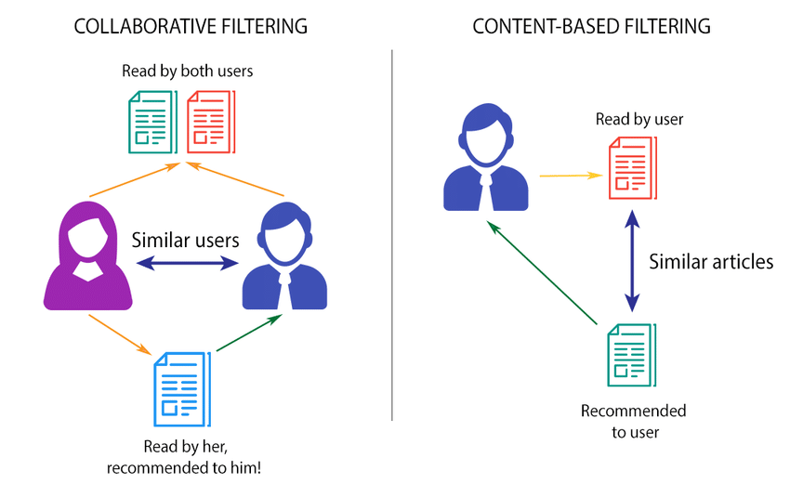
Collaborative Filtering Vs Content-based Filtering

Slide 6

Problem Formulation
Most of these companies give various recommendations to the users based on their likes and dislikes and keep the users engaged on their platform. These recommendations are only possible because of the collaborative filtering algorithm.

Slide 7

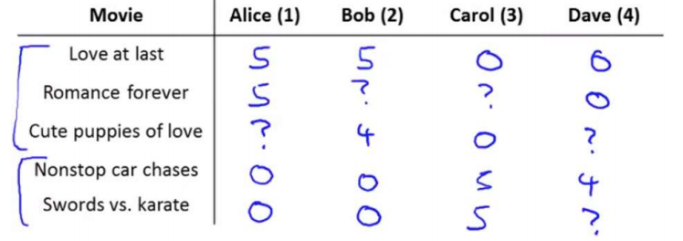
Suppose there are 5 films and 4 users. The ratings of the users for the movies are given below.
So let the first three movies fall into romantic genre and the rest into action and by the looks of the table Alice and Bob seems to like romantic movies and hate action movies at the same time we have Carol and Dave who seems to like action movies but hate romantic movies.

Slide 8

Dataset
In this project we will be performing collaborative filtering on the MovieLens 100k Dataset from GroupLens Research. This dataset consists of ratings on a scale of 1 to 5. The dataset has nu = 943 users, and nm = 1682 movies. We will be building a cost function and the gradient for the algorithm and we will use fmincg.m to learn the parameters for collaborative filtering.

Slide 9

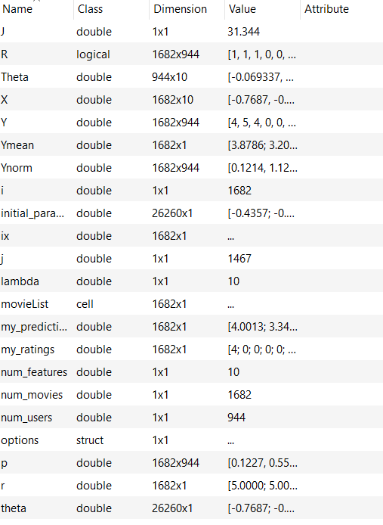

DATA
VARIABLES

Slide 10
Methodology
The first part of the script ex8_cofi.m will load the dataset ex8_movies.mat, providing the variables Y and R in your Octave/MATLAB environment. The matrix Y (a num movies × num users matrix) stores the ratings y (i,j) (from 1 to 5). The matrix R is an binary-valued indicator matrix, where R(i, j) = 1 if user j gave a rating to movie i, and R(i, j) = 0 otherwise. The objective of collaborative filtering is to predict movie ratings for the movies that users have not yet rated, that is, the entries with R(i, j) = 0. This will allow us to recommend the movies with the highest predicted ratings to the user.

Slide 11

Experimental Analysis
The basic setup required for the complete functioning of this project on a PC is a perfectly working Octave/Matlab GUI.
The first part of implementation of the collaborative filtering algorithm is writing a cost function (without regularization).

Slide 12
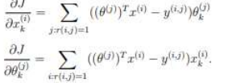
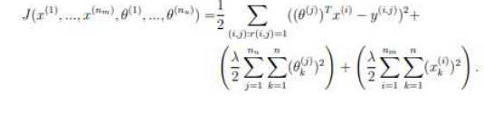
The next step is to write the gradient of this cost function. The gradients of this cost function is given by
The next step is writing a regularized cost function that performs better than the non regularized one

Slide 13
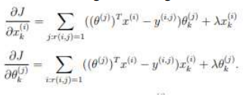
Now it is time to regularize the gradient.
All of our implementations are finished now it is time to train our model and pass the inputs.

Slide 14

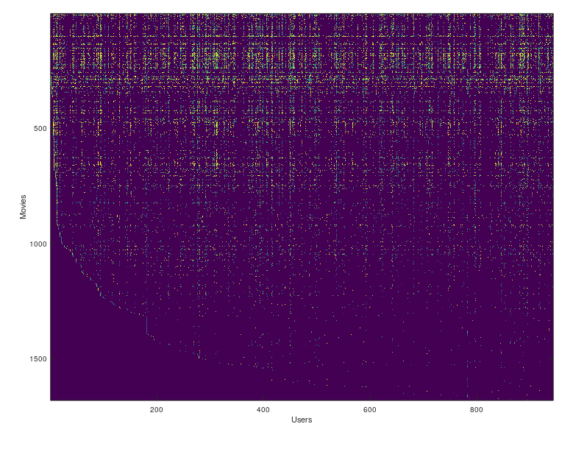

Slide 15
Checking Cost Functions and gradients without regularization
Cost at loaded parameters: 22.224604
Checking Gradients (without regularization) ...
4.627067 4.627067
2.511089 2.511089
3.581975 3.581975
0.353297 0.353297
……………………….
-0.020419 -0.020419
-1.749313 -1.749313
0.696072 0.696072
3.748512 3.748512
-0.859814 -0.859814
0.097699 0.097699
The above two columns you get should be very similar.
(Left-Your Numerical Gradient, Right-Analytical Gradient)
If your cost function implementation is correct, then
the relative difference will be small (less than 1e-9).
Relative Difference: 1.2747e-12

Slide 16
Checking cost function and gradients with regularization
Cost at loaded parameters (lambda = 1.5): 31.344056
Checking Gradients (with regularization) ...
-1.763802 -1.763802
0.490032 0.490032
5.572445 5.572445
-0.787346 -0.787346
-1.051921 -1.051921
……………
-2.590958 -2.590958
-3.235983 -3.235983
0.417496 0.417496
5.263597 5.263597
4.651891 4.651891
The above two columns you get should be very similar.
(Left-Your Numerical Gradient, Right-Analytical Gradient)
If your cost function implementation is correct, then
the relative difference will be small (less than 1e-9).
Relative Difference: 2.94833e-12

Slide 17
Movie Ratings
New user ratings:
Rated 4 for Toy Story (1995)
Rated 3 for Twelve Monkeys (1995)
Rated 5 for Usual Suspects, The (1995)
Rated 4 for Outbreak (1995)
Rated 5 for Shawshank Redemption, The (1994)
Rated 3 for While You Were Sleeping (1995)
Rated 5 for Forrest Gump (1994)
Rated 2 for Silence of the Lambs, The (1991)
Rated 4 for Alien (1979)
Rated 5 for Die Hard 2 (1990)
Rated 5 for Sphere (1998)

Slide 18
Result
The result will be the recommendation of the movies based on the input provided.
Training collaborative filtering...
Iteration 100 | Cost: 3.896648e+04
Recommender system learning completed.
After the recommender system performed the recommended movies are:
Top recommendations for you:
Predicting rating 5.0 for movie Someone Else's America (1995)
Predicting rating 5.0 for movie They Made Me a Criminal (1939)
Predicting rating 5.0 for movie Star Kid (1997)
Predicting rating 5.0 for movie Prefontaine (1997)
Predicting rating 5.0 for movie Entertaining Angels: The Dorothy Day Story (1996)
Predicting rating 5.0 for movie Aiqing wansui (1994)
Predicting rating 5.0 for movie Marlene Dietrich: Shadow and Light (1996)
Predicting rating 5.0 for movie Santa with Muscles (1996)
Predicting rating 5.0 for movie Great Day in Harlem, A (1994)
Predicting rating 5.0 for movie Saint of Fort Washington, The (1993)

Slide 19
Conclusion
Movie Recommendation systems proved themselves to be a best solution for addressing problem of the information overload. They help in taking choices by preserving time and energy. Future work will focus on enhancement of the existing methods and algorithms used so that the recommendation systems predictions and recommendations quality can be improved. Further this collaborative filtering algorithm can also be used in various ecommerce and music streaming applications and websites.

Slide 20

References
[1] Jian Hei, Kai Chen, Yi Zhou, “Collaborative filtering and deep learning based recommendation systems,” in School of Engineering and Applied Science, Aston University, Birmingham, B4 7ET, UK
[2] Daniel E. Acuna, Tulakan Ruangrong and Konrad Kording, “Science Concierge: A Fast Content-Based Recommendation System for Scientific Publications”

Slide 21


-BY
Ala Sai Vardhan Reddy
Mulla Thanuj Kumar Reddy
Dandala Bhagat Reddy
Ramagiri Nivas
Kota Rohit
Devendra Reddy Bakka

